Slide 1
STEP
Systematic Tracking of Exchanges in Procurement

Slide 2
STEP – Advantages
Procurement Planning & tracking
Procurement planning
Activity tracking
Implementation roadmap
Notification and alerts
Streamlining & automation
End-to-end processing
No-objection System
Document Management
Automated publications
Monitoring & Reporting
Portfolio Management
Project status review
Performance reporting
Business Intelligence

Slide 3
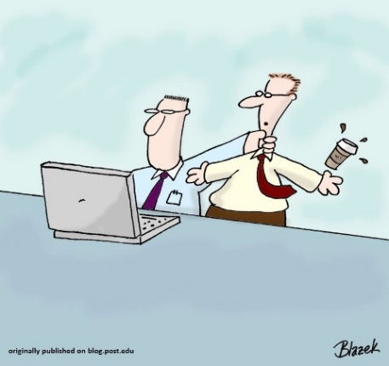
STEP: Features
New procurement methods - as per the new procurement framework
Partial on-line approval of procurement plan previously not available
Actual dates of procurement activities captured [provided entered !]

Slide 4
STEP: Features
United Nation’s Standard Procurement Service Code [UNSPSC] use is mandatory
STEP enables auto publication of approved procurement plan, publication notices and contract award information in the Bank’s external website, UNDB online, World Bank Finances App, and World Bank Procurement App
Client to enter information of bids evaluated, records of bidders

Slide 5
STEP: Features
STEP automatically populates information on any Debarred List /Temporary Suspensions List hit firms when you choose the supplier/contractor/firm name for recommendation of award/shortlist
The Client is required to enter both prior and post review activities to be able to capture/generate the report to monitor progress of the project. Evaluation report details are however required to be entered only for prior review activities

Slide 6
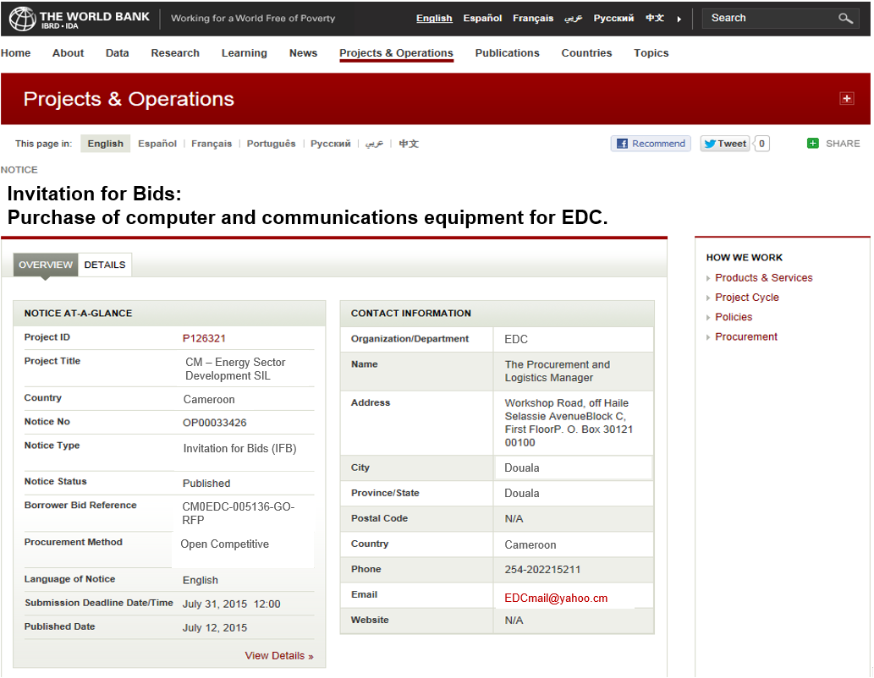
STEP: Features : Automatic publication of Procurement Notices
Automated Publication to 4 electronic outlets
United Nations Development Business
www.worldbank.org
World Bank Finances App
World Bank Procurement App
1
2
Automated Publication
3
4

Slide 7
STEP : System Set Up :
System generated notification once the project is setup in STEP by the Bank

Slide 8
STEP : Using the System : Preferred Browsers, and URL Preferred Browser : Google Chrome Other browsers that support STEP : Internet Explorer, Firefox Accessing the System : URL : www.step.worldbank.org Click on : ‘LOGIN’

Slide 9
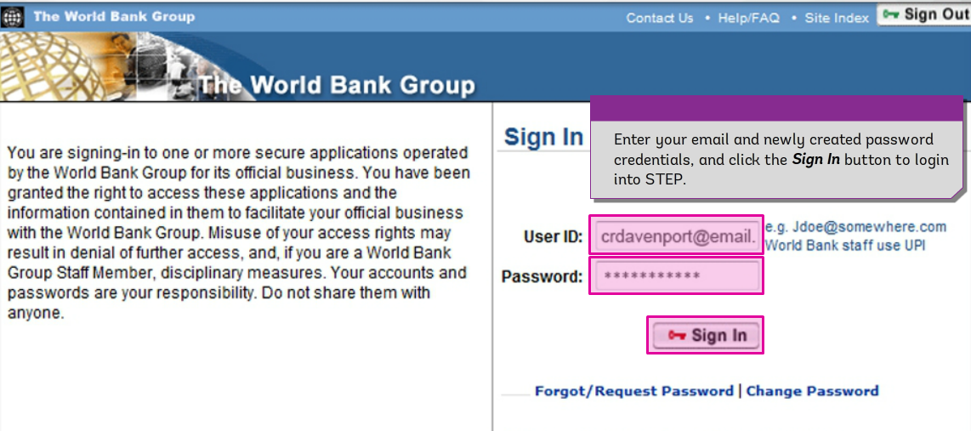
STEP : Log In Screen

Slide 10
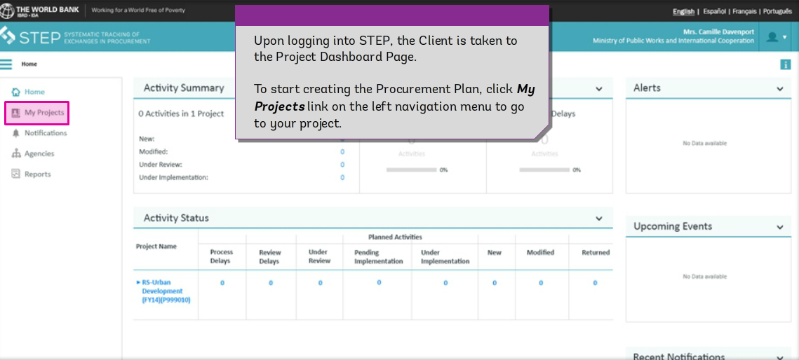
STEP : View of Project Dashboard
Upon logging into STEP, you are taken to the Project Dashboard Page.

Slide 11
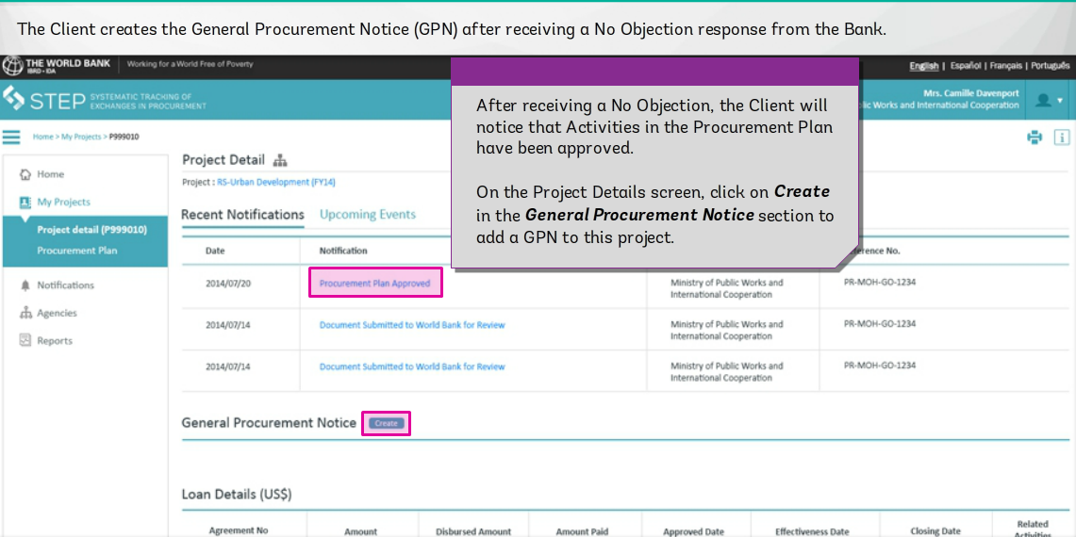
STEP : Creating a General Procurement Notice-Step 1
On the Project Details screen, click on Create in the General Procurement Notice section to add a GPN to this project

Slide 12
STEP : Creating a General Procurement Notice-Step 2

Slide 13
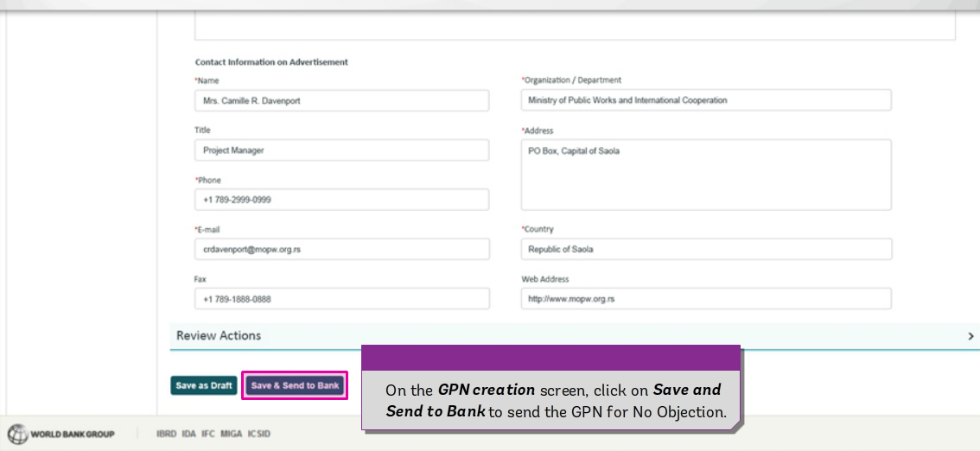
STEP : Creating a General Procurement Notice-Step 3

Slide 14
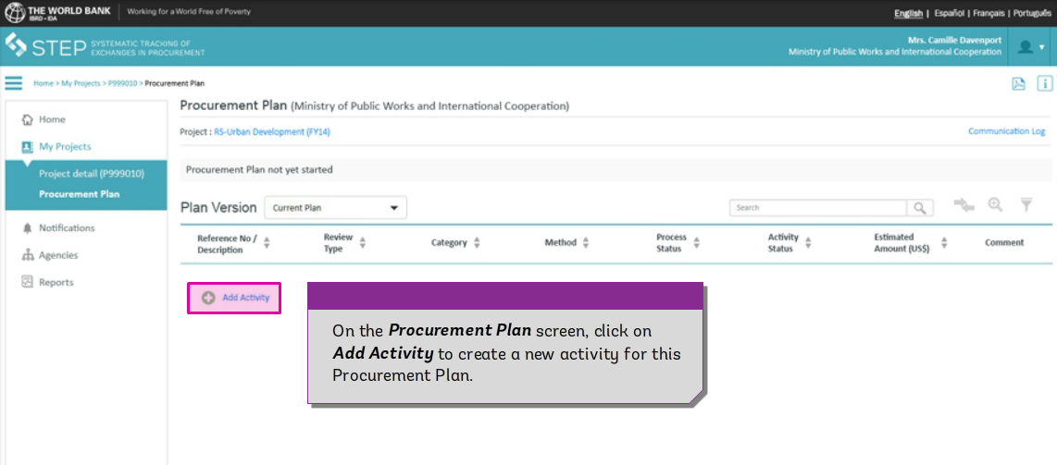
STEP : Creating a Procurement Plan – Step 4 – Adding a New Activity

Slide 15
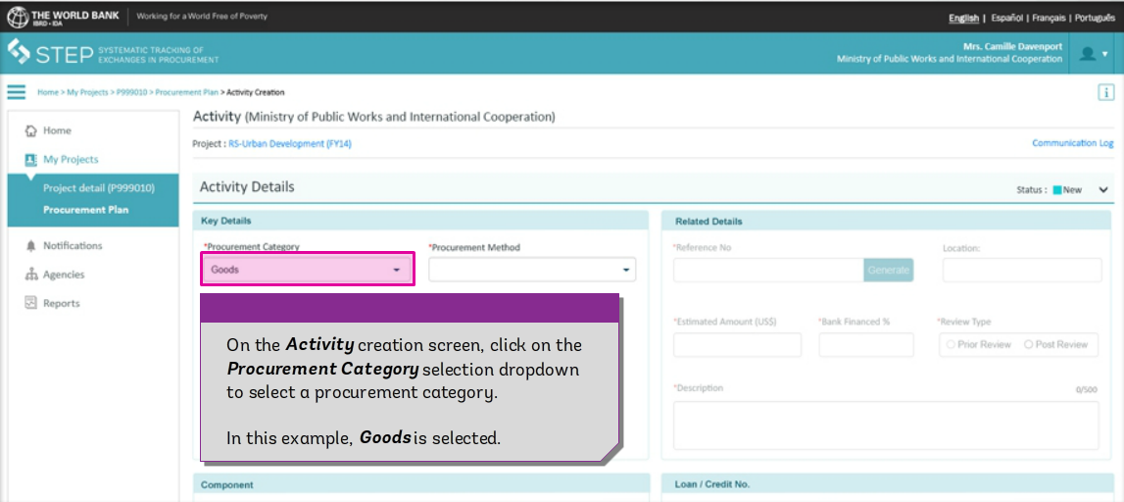
STEP : Creating a Procurement Plan – Step 5 -
Choosing Category/Method/Description of Procurement

Slide 16
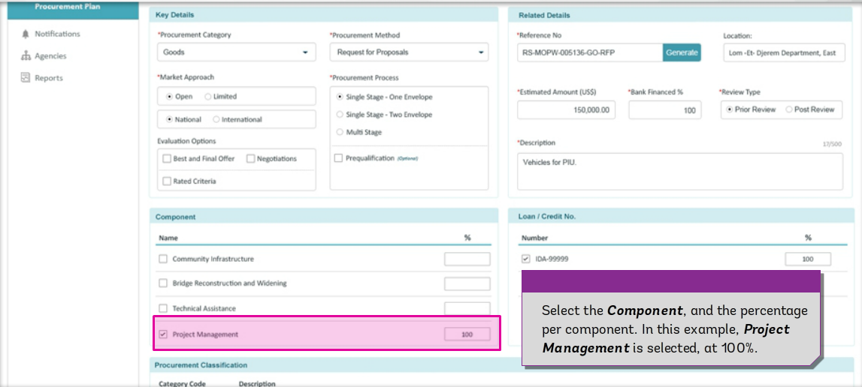
STEP : Creating a Procurement Plan – Step 6:
Choosing Applicable Project Component

Slide 17
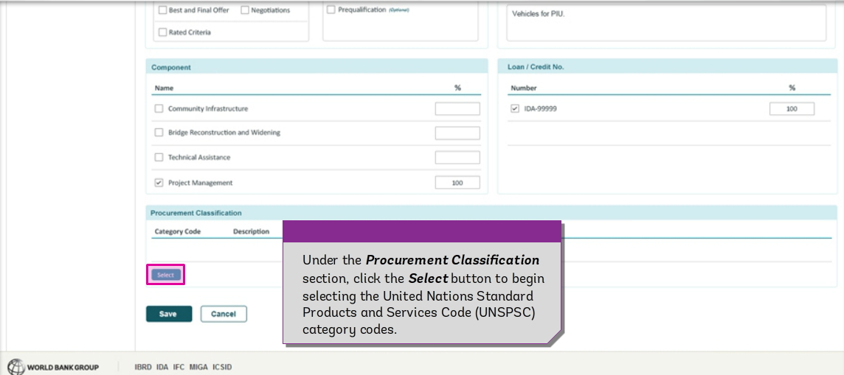
STEP : Creating a Procurement Plan – Step 7 :
Choosing Applicable UNSPSC Category Code

Slide 18
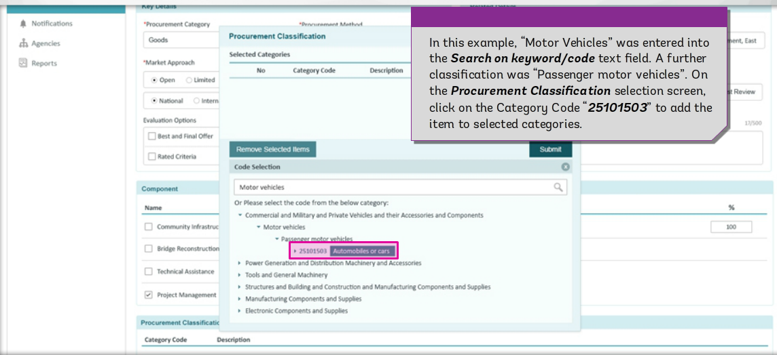
STEP : Creating a Procurement Plan – Step 8 :
Choosing Applicable UNSPSC Category Code [Contd.]

Slide 19
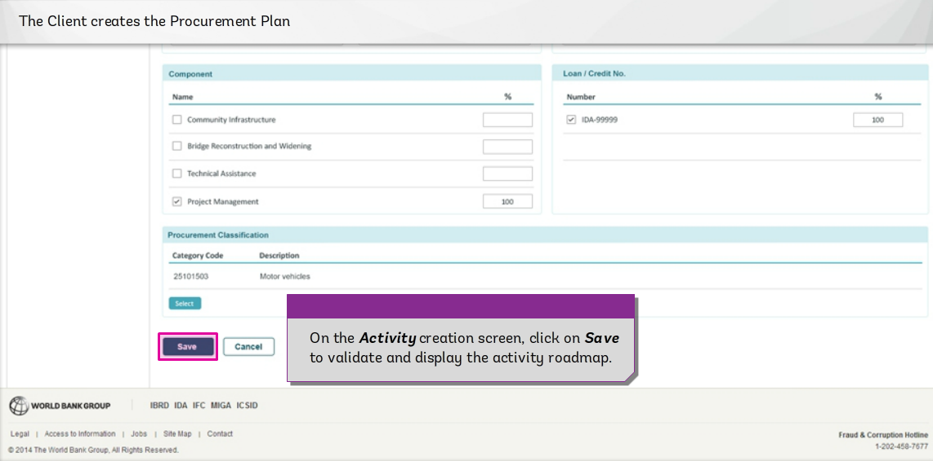
STEP : Creating a Procurement Plan – Step 9 :
Saving a Procurement Activity

Slide 20
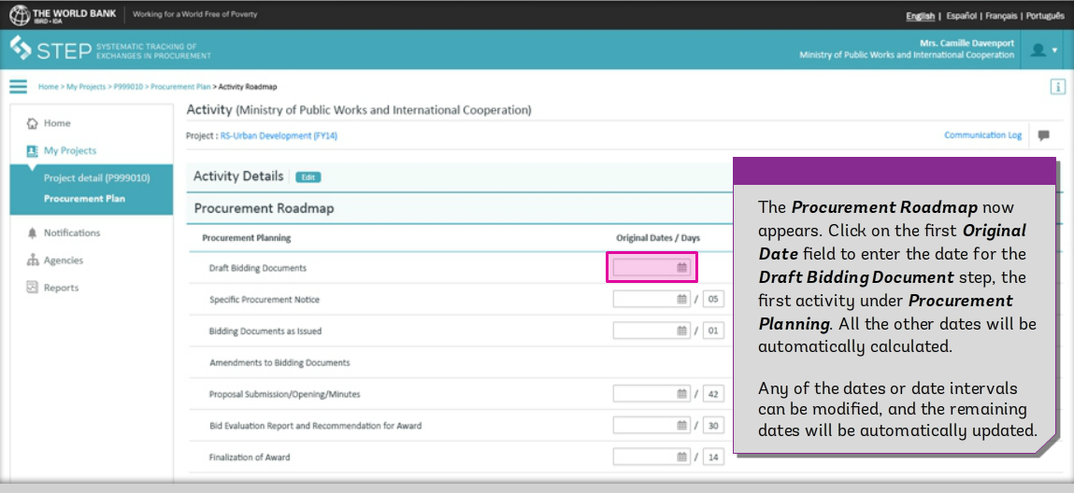
STEP : Creating a Procurement Plan – Step 10 :
Procurement Road Map Giving Realistic, Estimated
Procurement Timelines

Slide 21
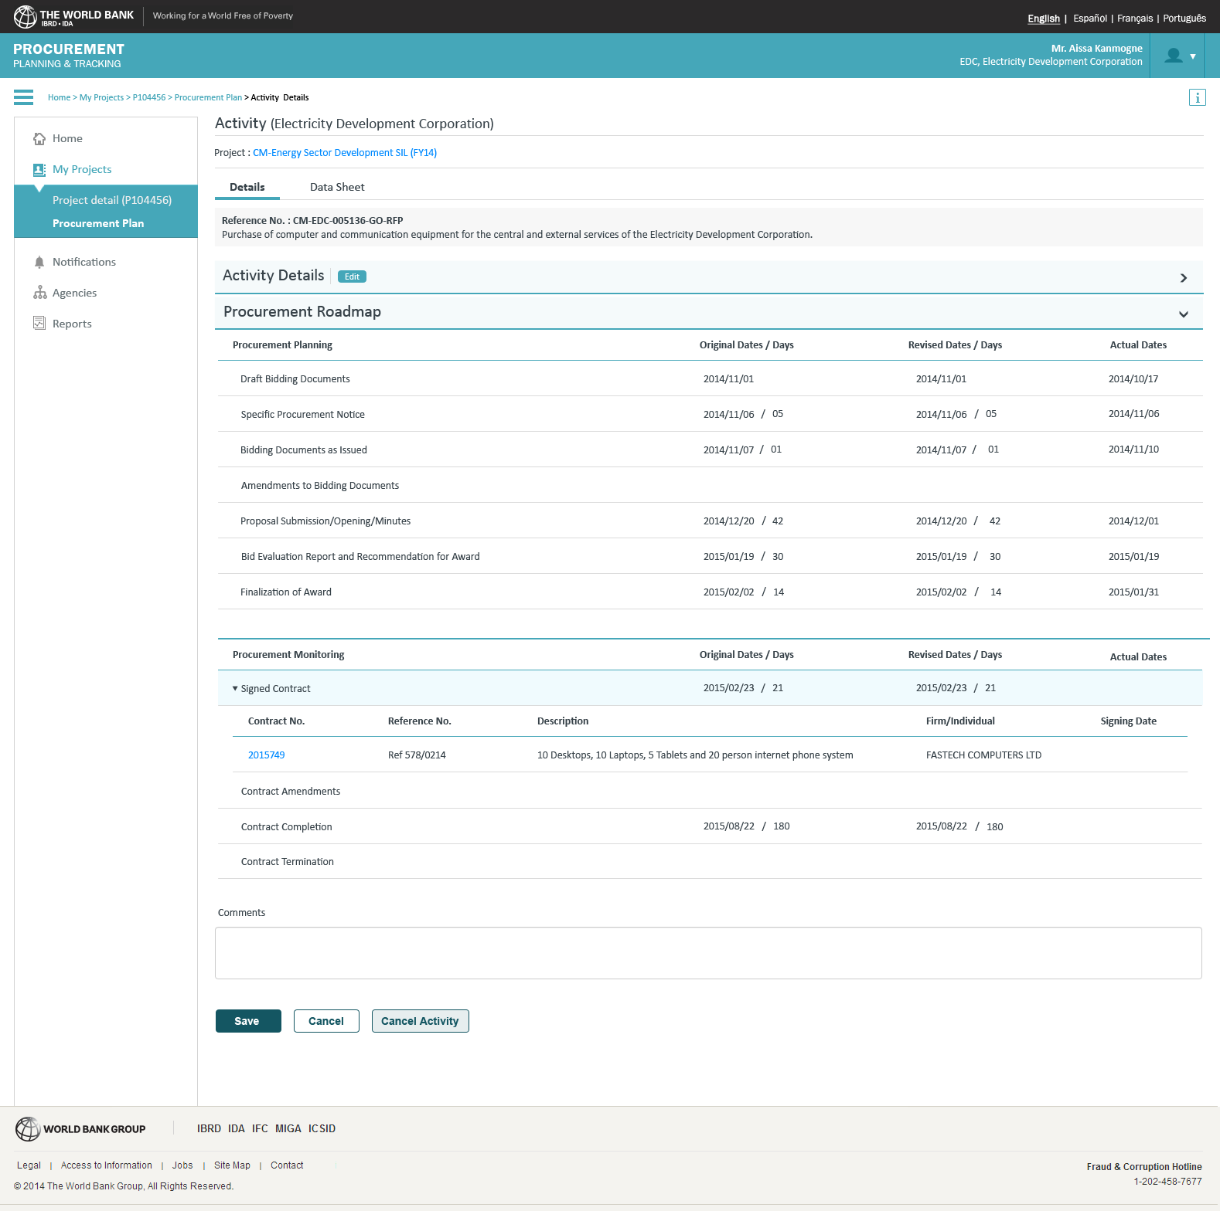
STEP : Updating a Procurement Plan – Step 11 :
As Required/Annual/Bi-annual Basis
Original Dates
Revised Dates
Actual Dates
Comments

Slide 22
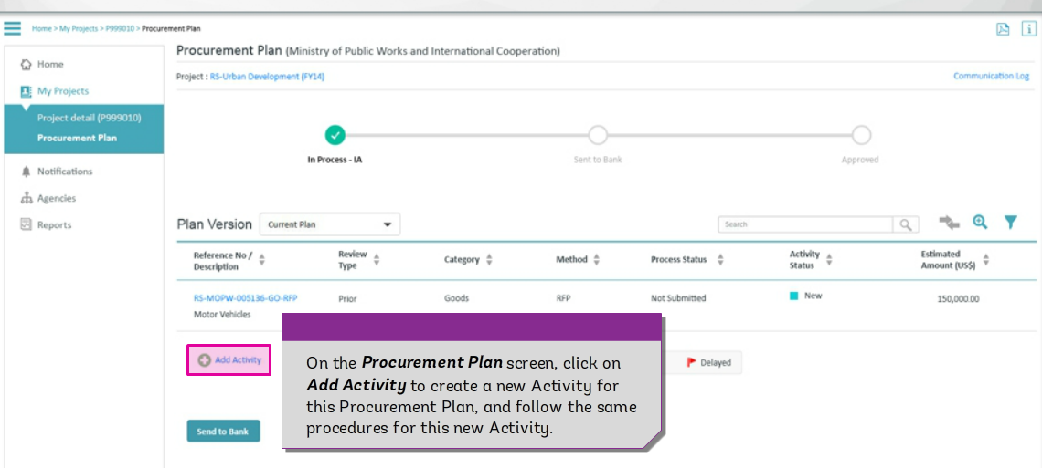
STEP : View of New Procurement Activity &
Option of Sending Activity to the Bank – Step 12:

Slide 23
STEP : Sending a Procurement Plan to the Bank - Step 13
Formulating a Forwarding Email to the Bank

Slide 24
STEP : Communication Log

Slide 25
STEP : Communication Log

Slide 26
STEP : View of Procurement Activities in Procurement Plan- Step 10

Slide 27
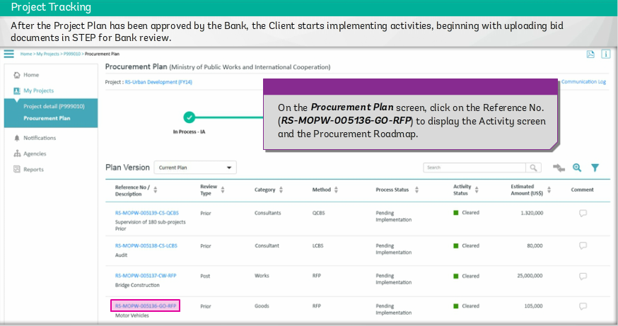
STEP : Uploading bid documents - Step 1

Slide 28
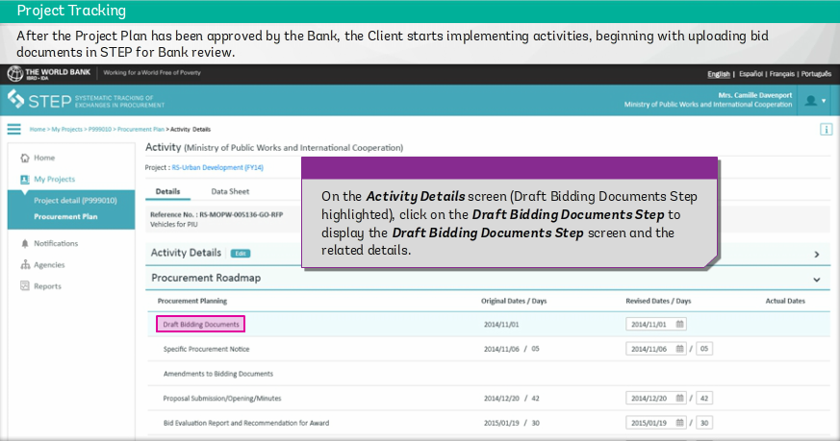
STEP : Uploading bid documents - Step 2

Slide 29
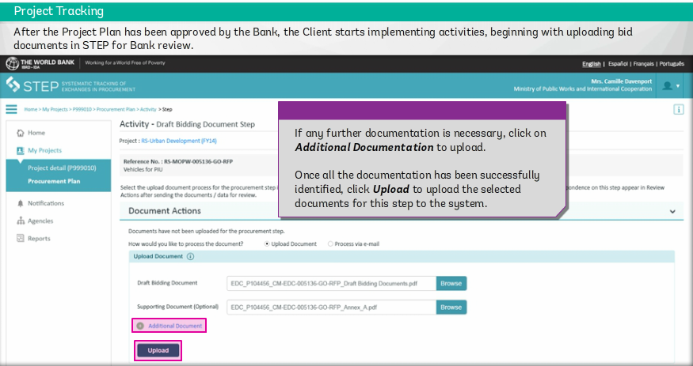
STEP : Uploading bid documents - Step 3

Slide 30
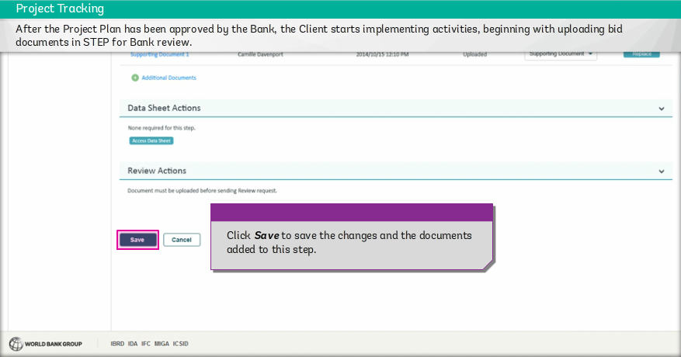
STEP : Uploading bid documents - Step 4
Save

Slide 31
STEP : Uploading bid documents - Step 5
Send to Bank

Slide 32
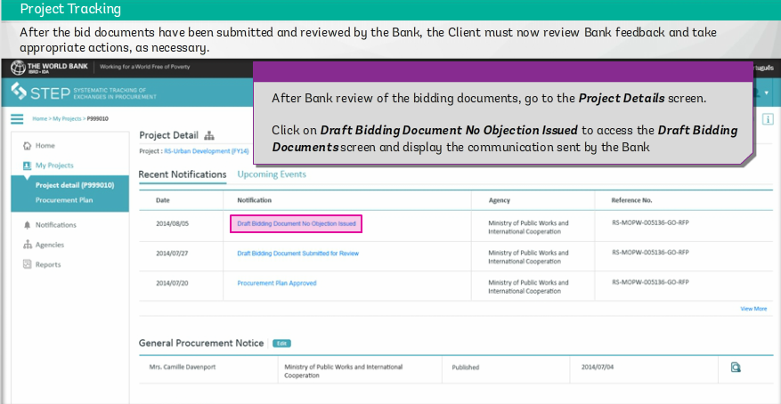
STEP : Draft Bidding Document No Objection Issued

Slide 33
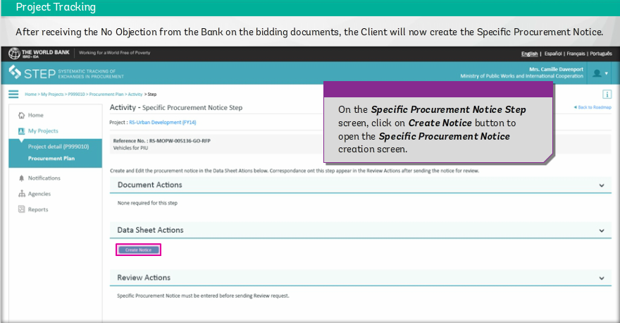
STEP : Create Notice – Specific Procurement Notice – Step 1

Slide 34
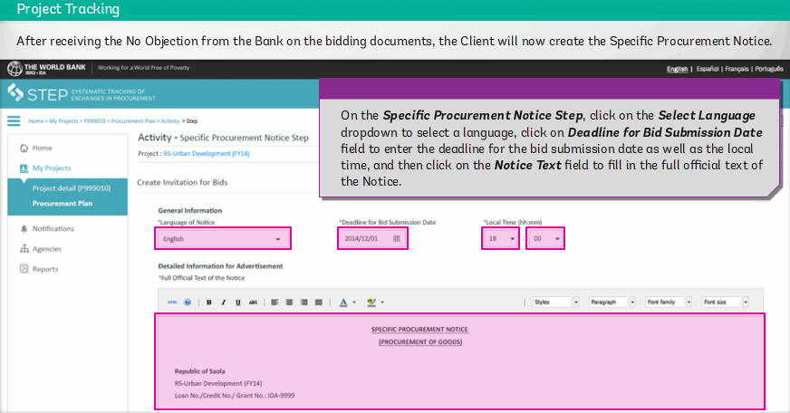
STEP : Create Notice – Specific Procurement Notice – Step 2

Slide 35
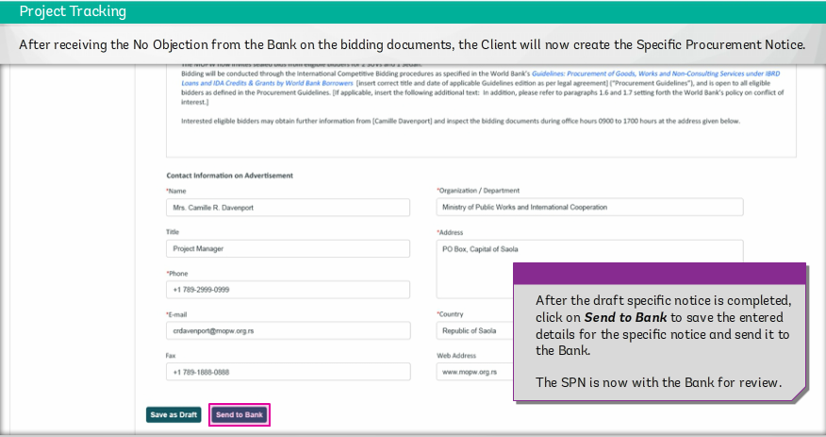
STEP : Create Notice – Specific Procurement Notice – Step 3

Slide 36
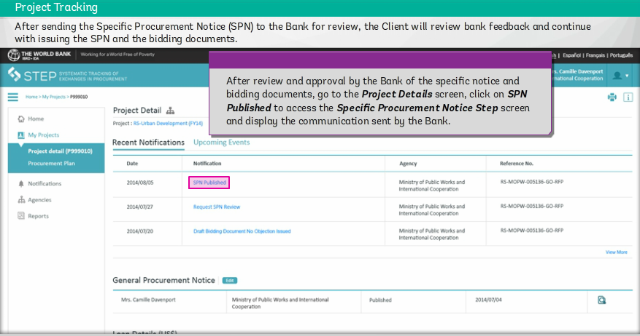
STEP : Create Notice – Specific Procurement Notice – Step 4
Notice gets published automatically.

Slide 37
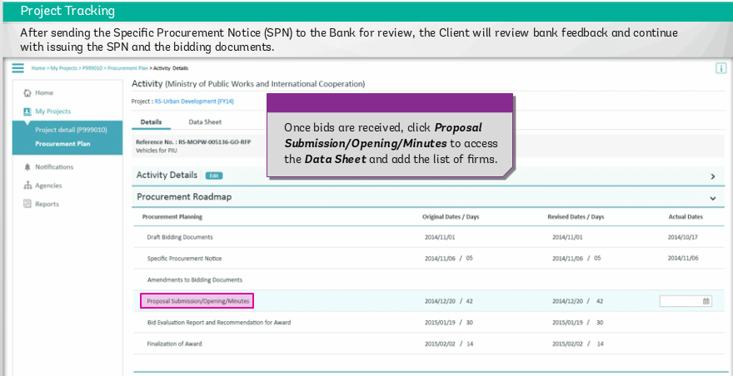
STEP : Proposal Submission/Opening/Minutes - Step 1

Slide 38
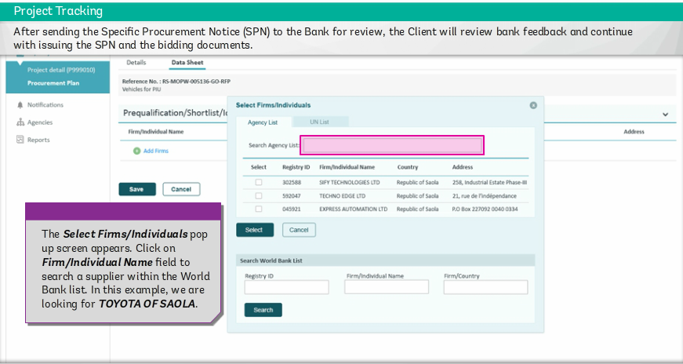
STEP : Proposal Submission/Opening/Minutes - Step 2

Slide 39
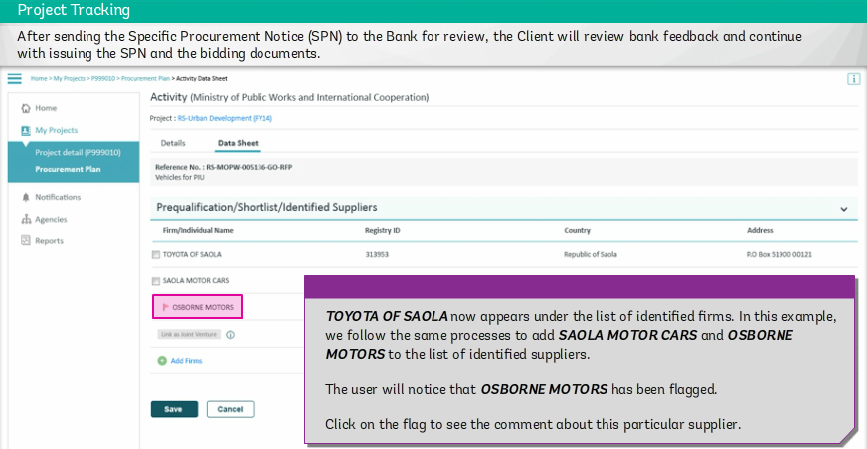
STEP : Proposal Submission/Opening/Minutes - Step 3

Slide 40
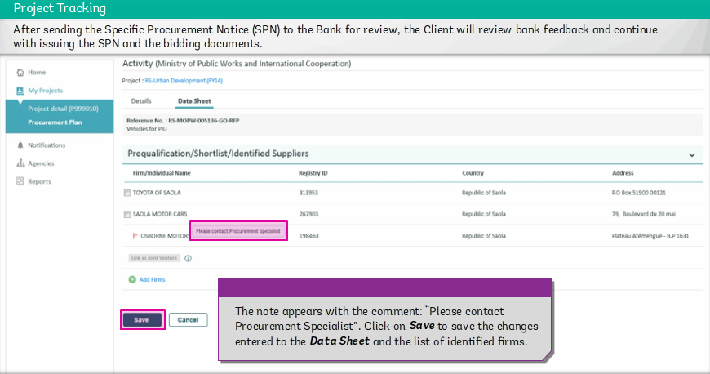
STEP : Proposal Submission/Opening/Minutes - Step 4

Slide 41
STEP : Proposal Submission/Opening/Minutes - Step 5

Slide 42
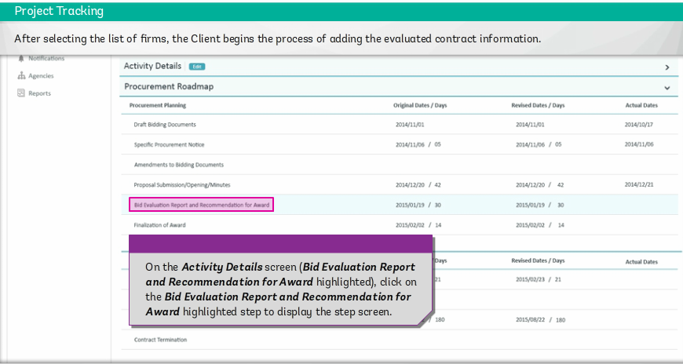
STEP : Details of Bid Evaluation Report - Step- 1

Slide 43
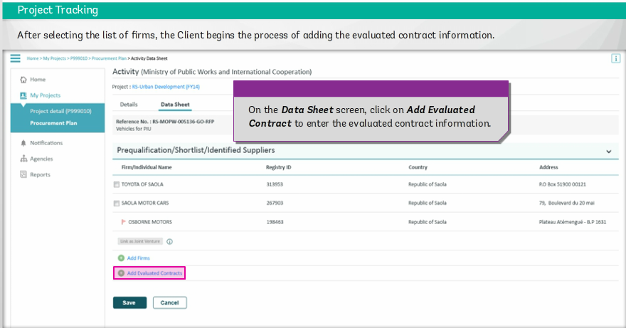
STEP : Details of Bid Evaluation Report - Step- 2

Slide 44
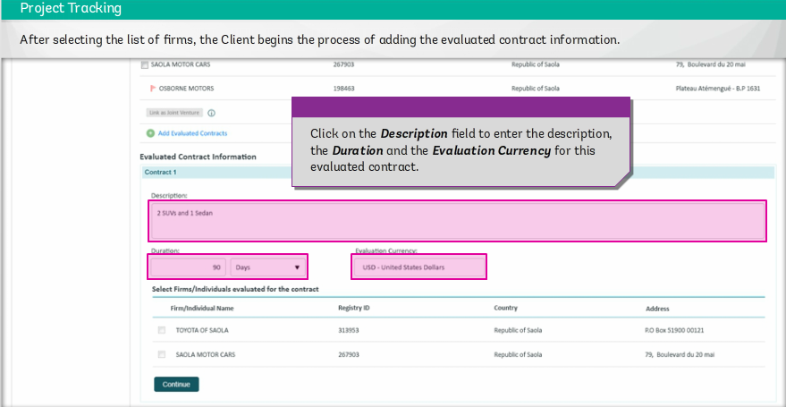
STEP : Details of Bid Evaluation Report - Step- 3

Slide 45
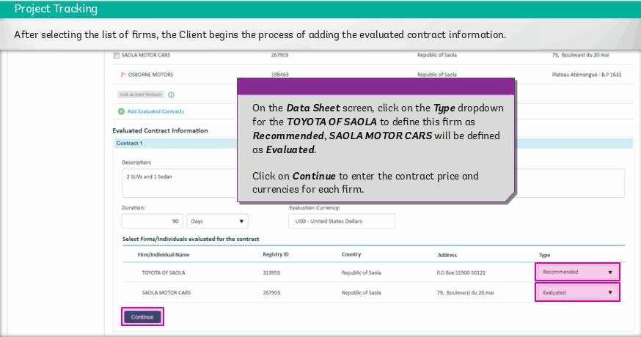
STEP : Details of Bid Evaluation Report - Step- 4

Slide 46
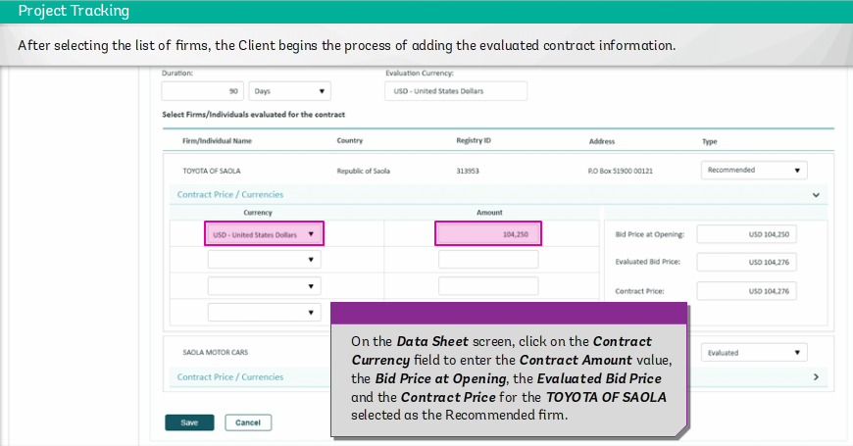
STEP : Details of Bid Evaluation Report - Step- 5

Slide 47
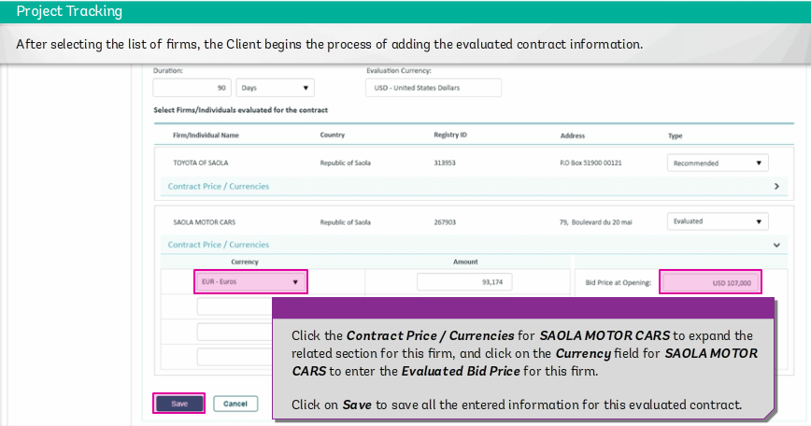
STEP : Details of Bid Evaluation Report - Step- 6

Slide 48
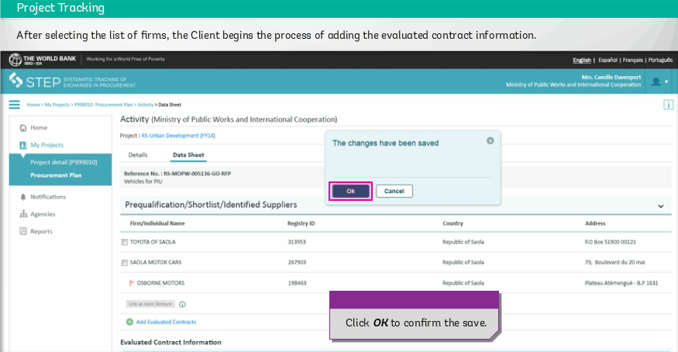
STEP : Details of Bid Evaluation Report - Step- 7

Slide 49
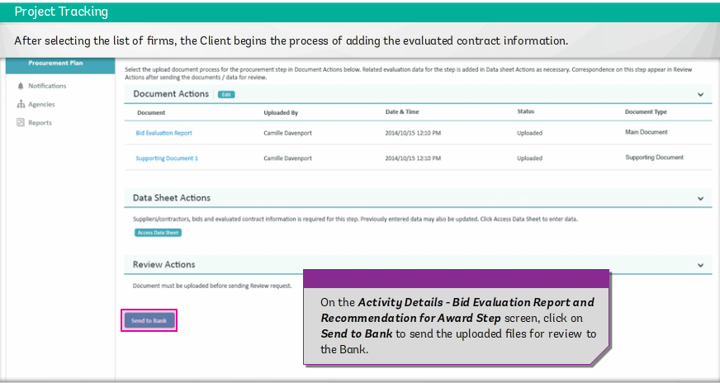
STEP : Details of Bid Evaluation Report - Step- 8

Slide 50
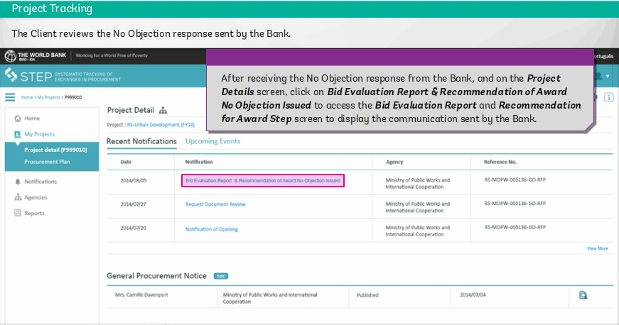
STEP : Details of Bid Evaluation Report - Step- 9

Slide 51
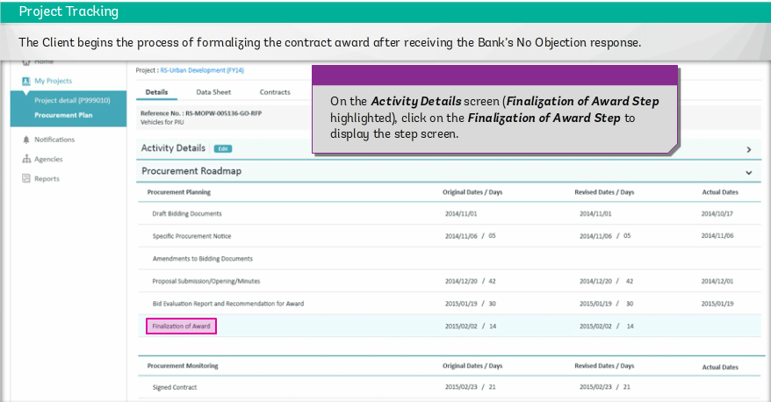
STEP : Finalization of Award - Step- 1

Slide 52
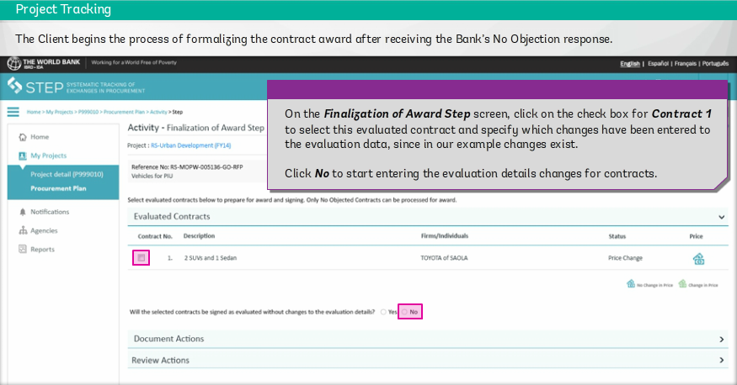
STEP : Finalization of Award- Step- 2

Slide 53
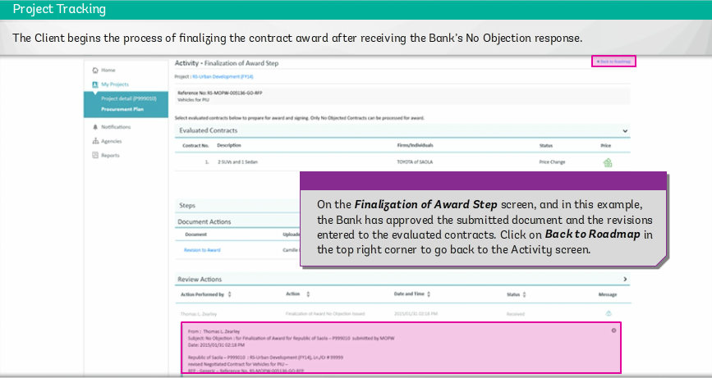
STEP : Finalization of Award- Step- 3

Slide 54
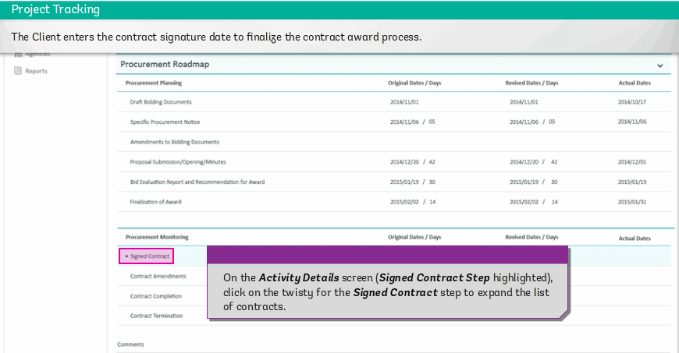
STEP : Signed Contract Stage - Step- 1

Slide 55
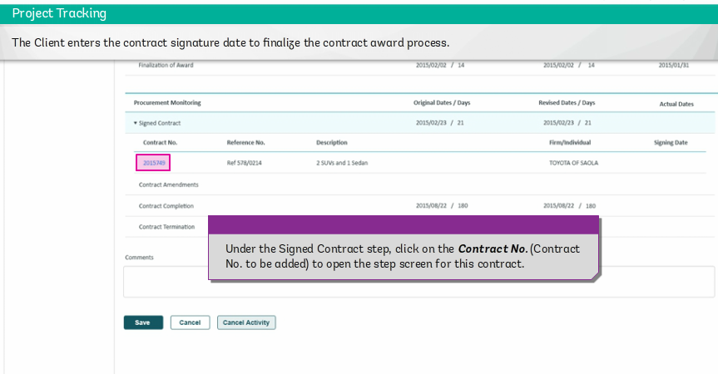
STEP : Signed Contract Stage - Step- 2

Slide 56
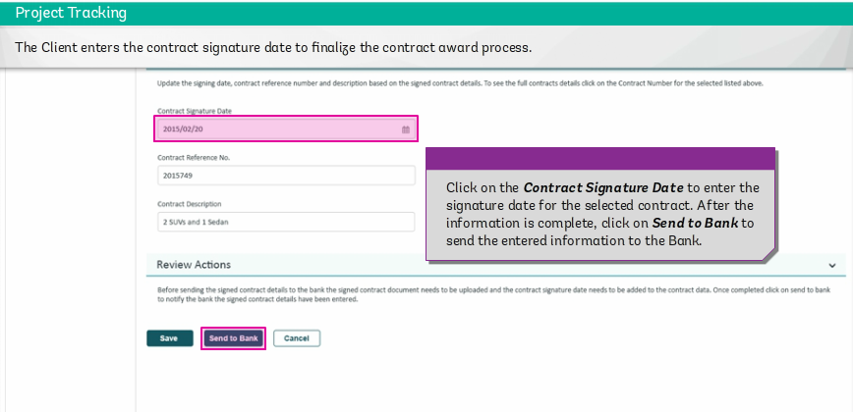
STEP : Signed Contract Stage - Step- 3

Slide 57
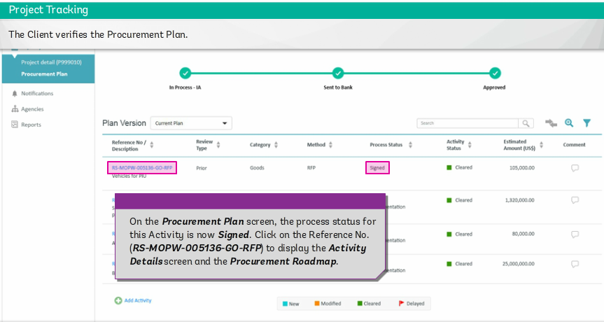
STEP : Signed Contract Stage - Step- 4

Slide 58
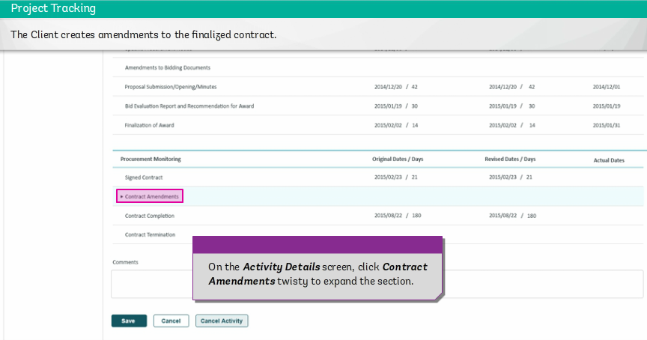
STEP : Amendment to Contract - Step- 1

Slide 59
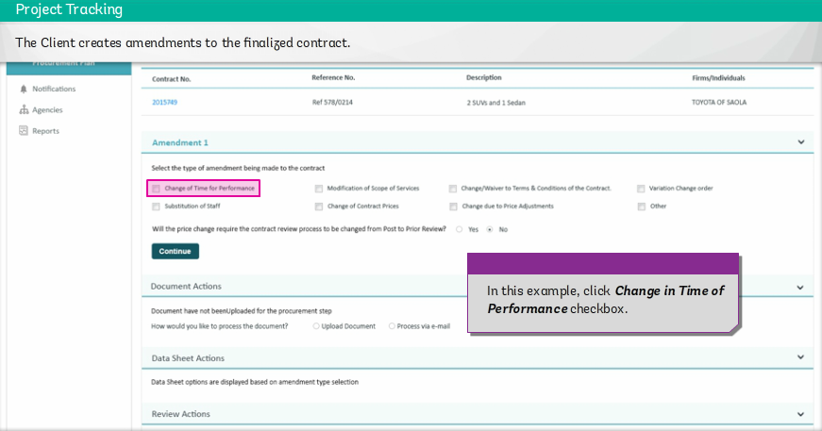
STEP : Amendment to Contract - Step- 2

Slide 60
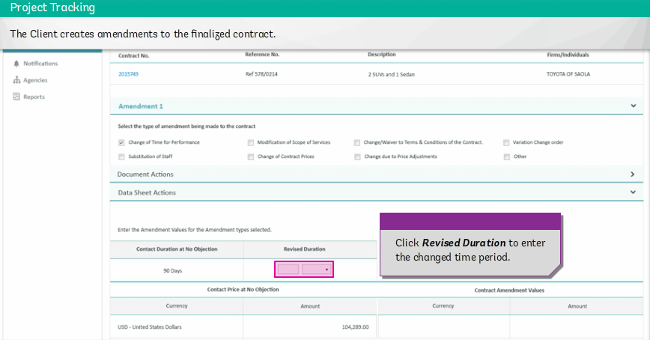
STEP : Amendment to Contract - Step- 3

Slide 61
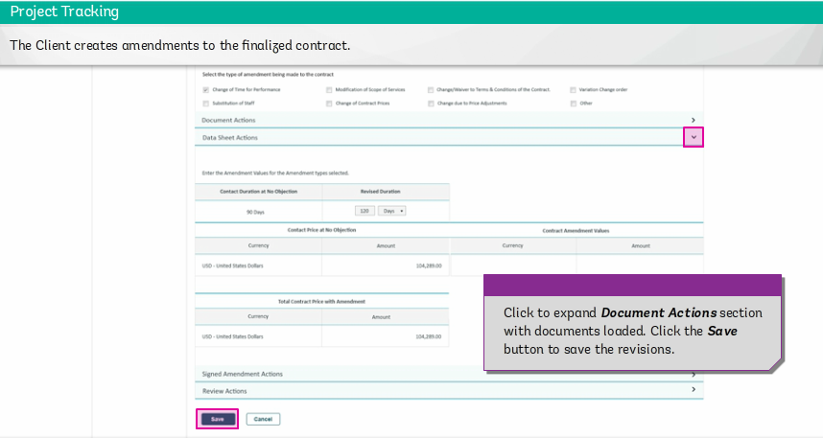
STEP : Amendment to Contract - Step- 4

Slide 62
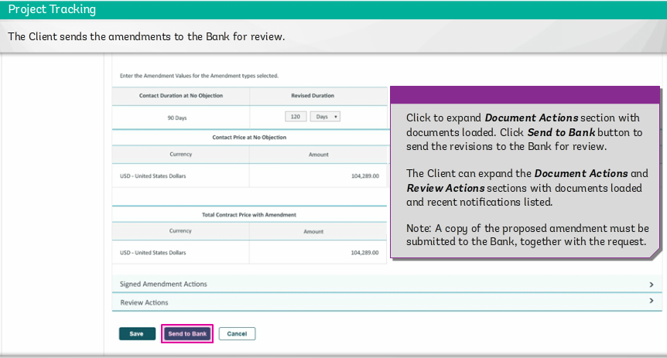
STEP : Amendment to Contract - Step- 5

Slide 63
STEP: Client monitoring dashboard

